Slide 1
Team 1
Sprint 3

Slide 2
Agenda
Sprint 2 Review/Retrospective
User Feedback and Competitor Research
MVP-1 Features and Demo
Future Work Planned

Slide 3
Sprint 2 Review/Retrospective Highlights
What went well?
Collaboration
Jira tasks and tracking
What didn’t go well?
Git PR reviews and feedback
Visibility of research
How will we Improve?
More thorough reviews in PR(s) and increased feedback.
Share research by giving the team or relevant members a brief presentation when finished.
Sprint 3 goal(s)
Finish MVP-1
Competitor research and initial customer feedback

Slide 4
Criteria of Evaluation
Cost
Ease of use
Features
Customer feedback

Slide 5



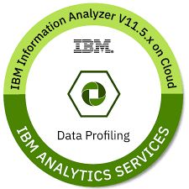

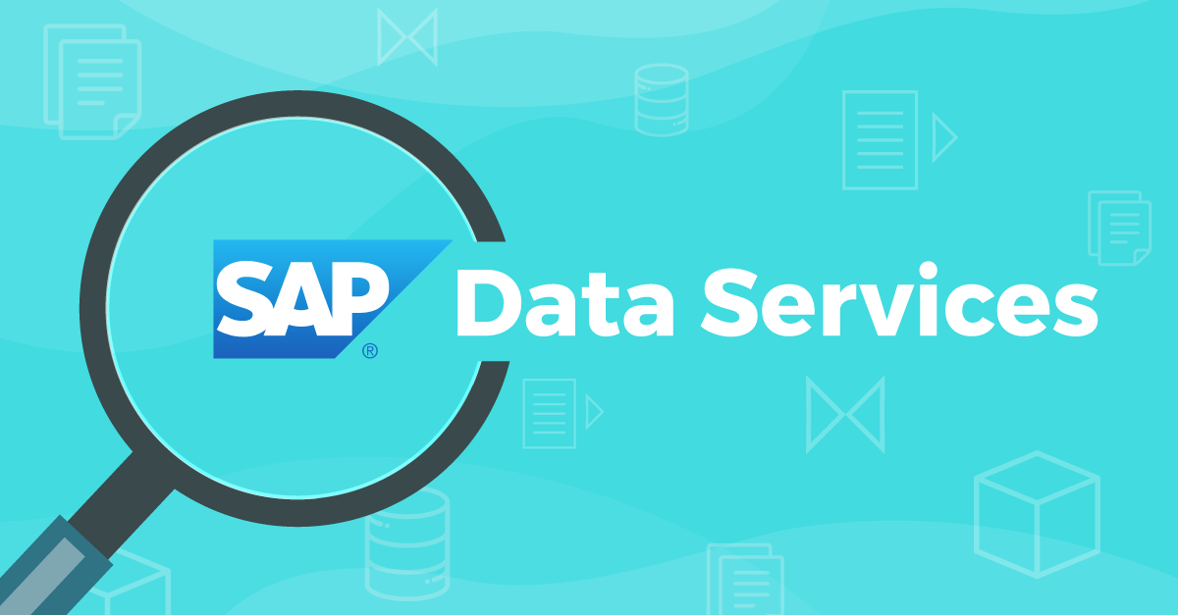
COST
Free
Paid

Slide 6

COST
DataPolish
Free
Paid

Slide 7


Slide 8

STUDENT – EASE OF USE
EASY
HARD

Slide 9
STUDENT – EASE OF USE
DataPolish
EASY
HARD

Slide 10

Features

Slide 11

Features

Slide 12

Features
Data Transforming

Slide 13

Features
Data Transforming
Data Exploration

Slide 14
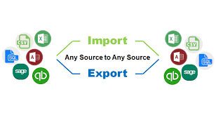
Features
Data Transforming
Data Exploration
Data Import & Export

Slide 15
Common Features
Data Standardization
Data Validation
Data Integration
Data Matching
Data Enrichment
Address Verification/Cleaning
Text Data Processing
Data Profiling
ETL Capabilities
Data Cleansing

Slide 16
Unique Features
Data Quality Monitoring:
Undo/Redo Stack:
Data Governance:
Parallel Processing:.
Geocoding:

Slide 17
Competitor Research (Oracle Analytics)
What they do well?
They have a rich suite of ETL, Visualization and Machine Learning functions.
They have both a cloud and desktop version.
They have a clean UI
What do they do not so well?
Can be a steep learning curve for learning the new features.
Desktop version is buggy on M1 macs.
Card details required (Pay walled)
Does not work as well outside the Oracle eco system
Where can we differentiate?
More focused features for data cleaning (No need for ETL or ML functions).
Simpler to use.
More focused towards student demographic

Slide 18

Customer feedback

Slide 19
Customer feedback
4 Interviews

Slide 20
Customer feedback
DataPolish
4 Interviews
Loved DataPolish

Slide 21
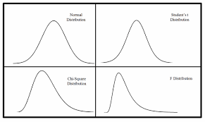

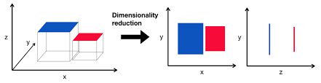
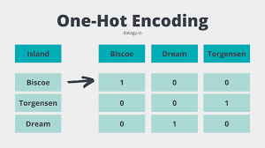
Customer feedback
DataPolish
4 Interviews
Loved DataPolish
Idea Generators

Slide 22
MVP-1 Feature List
Data Upload
Currently limited to comma delimited csv’s with standard structured data format (column names on row 1, data on row 2)
Data Profiling
Standard data quality checks such as missing values, outlier detection and more.
Data profile dashboard using static python plots that show the user the quality of their data.
Data cleaning
Duplicate removal. (Current MVP does not have functionality for column specific data cleaning tasks like cleaning missing values)
Data Export
User can export their newly cleaned data to their local machine and begin analysis.

Slide 23
Future Work Planned
Collect more user feedback with MVP-1
Make data profile dashboard interactive with D3.js
Increase data cleaning functionality with user input allowing users to clean specific columns
Work on stable deployment (CI/CL)

